Slide 1
컴퓨터는 어떻게 객체를 탐지할까?
2022.05.11.
ZeroPage oms

Slide 2
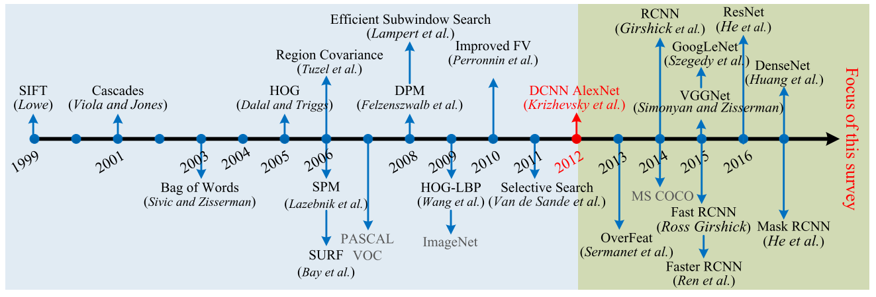
Object detection? (1)

Slide 3
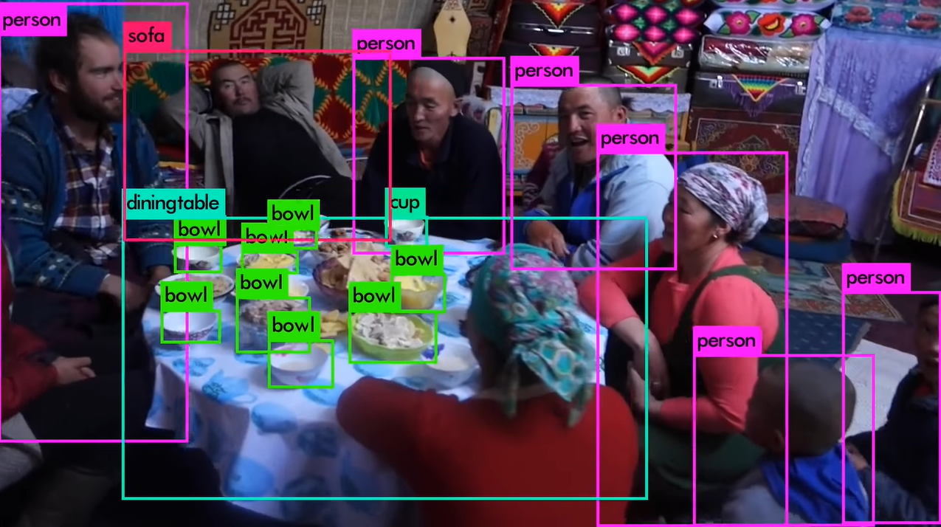
Object detection? (2)
https://youtu.be/MPU2HistivI?t=92

Slide 4

Computer vision?

Slide 5
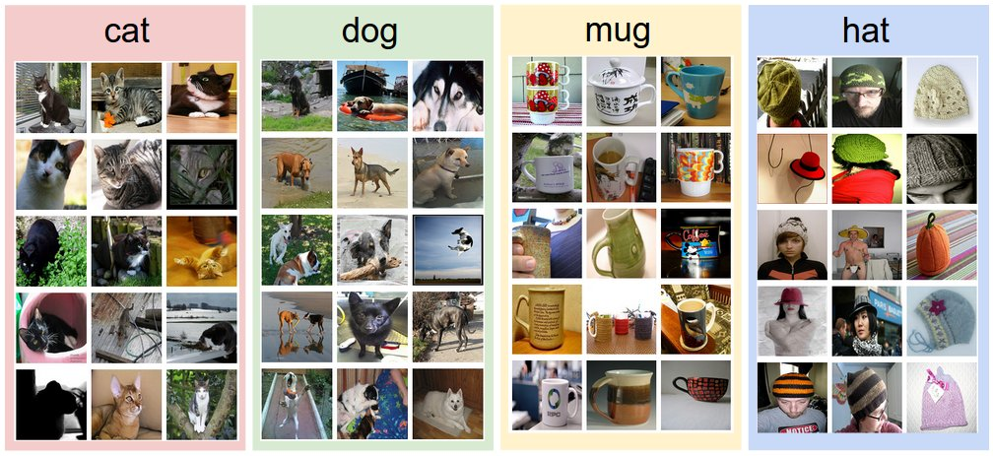
Classification(1)
CS231n Convolutional Neural Networks for Visual Recognition

Slide 6
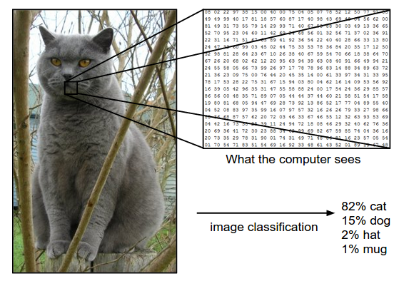
Classification(2)
248 x 400 x 3
that ranges from 0 (black) to 255 (white).
to turn this into a single label, such as ”cat”.
CS231n Convolutional Neural Networks for Visual Recognition

Slide 7
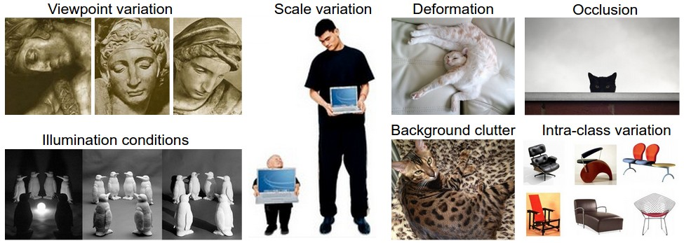
Classification(3)
CS231n Convolutional Neural Networks for Visual Recognition

Slide 8
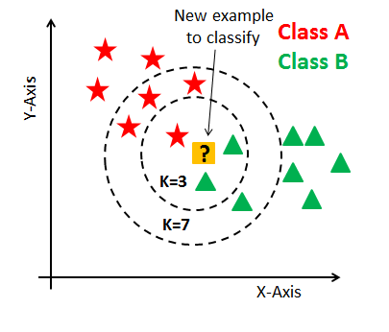
Data-driven approach – kNN (1)
KNN Classification Tutorial using Sklearn Python | DataCamp

Slide 9
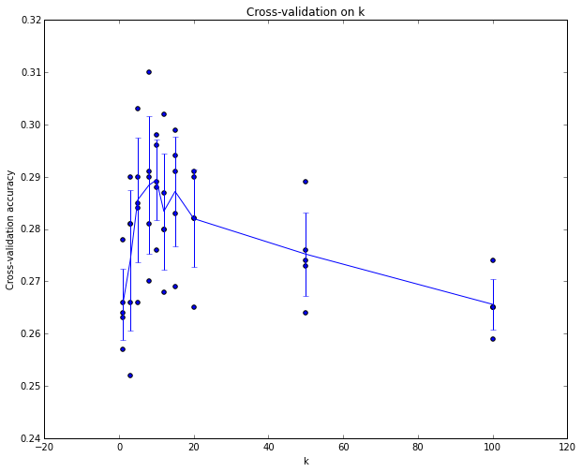
Data-driven approach – kNN (2)
CS231n Convolutional Neural Networks for Visual Recognition

Slide 10
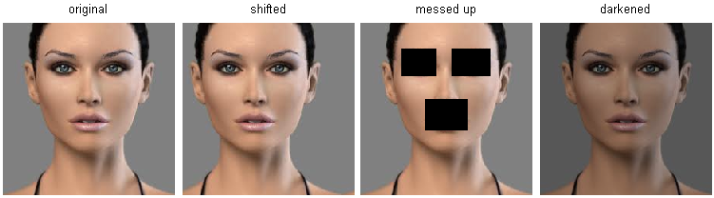
Data-driven approach – kNN (3)
Inefficient

Slide 11
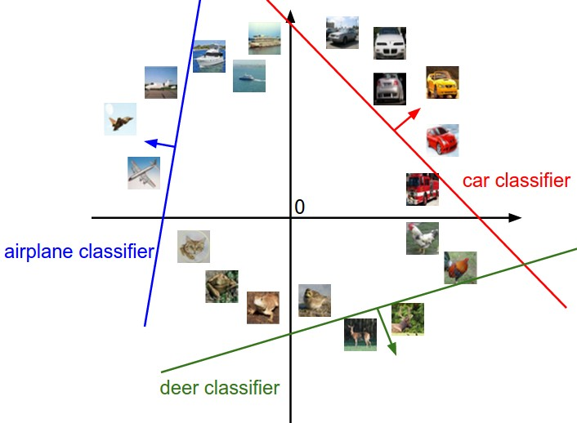
Data-driven approach - svm
CS231n Convolutional Neural Networks for Visual Recognition

Slide 12
Classification(4)
1. Classifier – kNN, svm …
2. Feature extraction

Slide 13
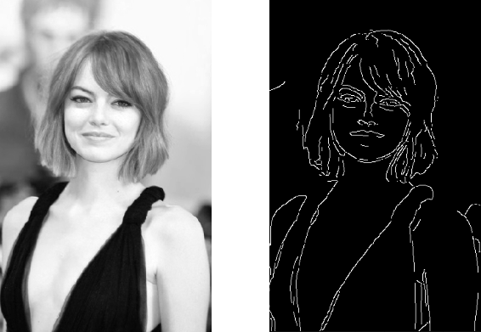
Feature extraction
Canny Edge Detection Step by Step in Python — Computer Vision | by Sofiane Sahir | Towards Data Science

Slide 14
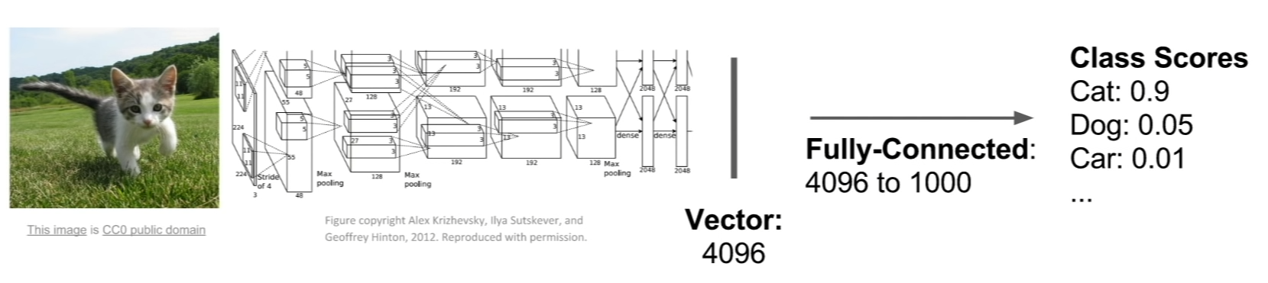
alexnet
Lecture 11 | Detection and Segmentation - YouTube

Slide 15

cnn
CS231n Convolutional Neural Networks for Visual Recognition

Slide 16
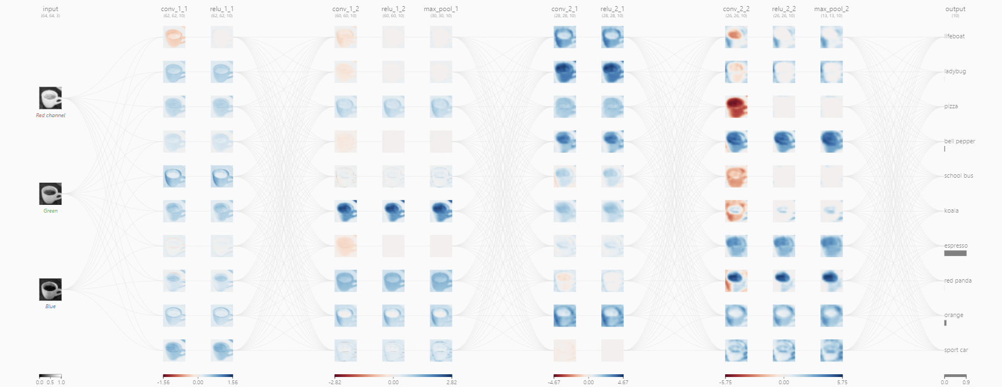
cnn
CNN Explainer (poloclub.github.io)

Slide 17
To what extent do the CNN classification results on ImageNet generalize to object detection results on the PASCAL VOC Challenge?

Slide 18
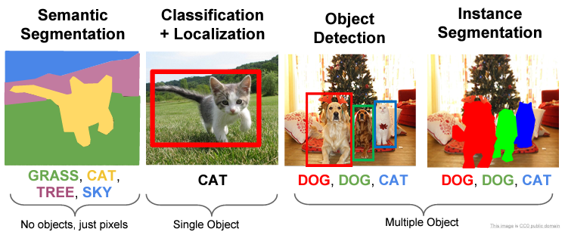
Object detection

Slide 19
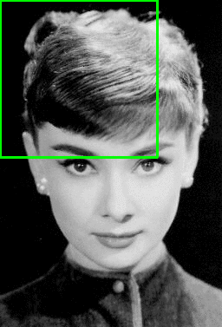
Localization (1) – sliding window
Sliding Windows for Object Detection with Python and OpenCV - PyImageSearch

Slide 20
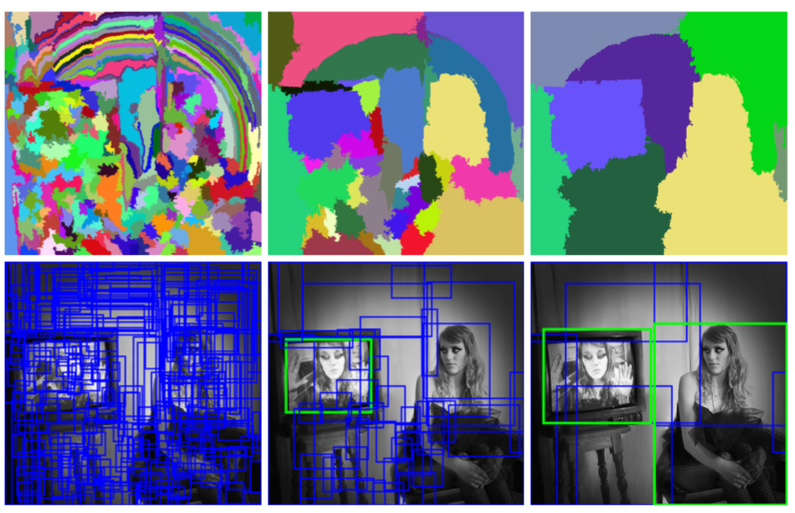
Localization (2) – selective search
Selective Search Explained | Papers With Code

Slide 21
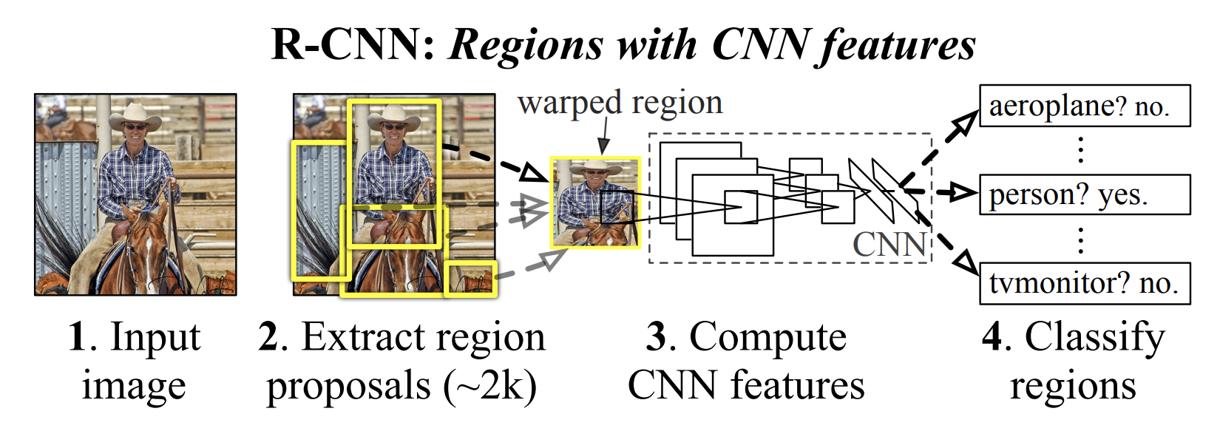
R-cnn (1)
1311.2524.pdf (arxiv.org)

Slide 22
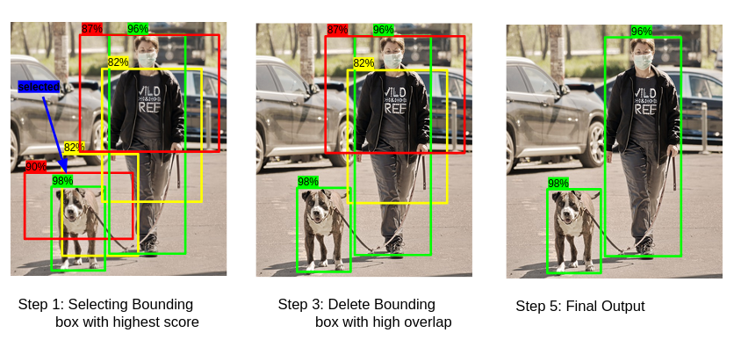
Non maximum suppression (nms)
Selecting the Right Bounding Box Using Non-Max Suppression (with implementation) (analyticsvidhya.com)

Slide 23
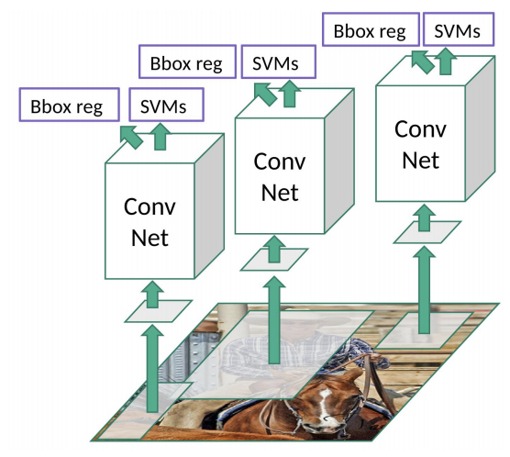
R-cnn (2)

Slide 24
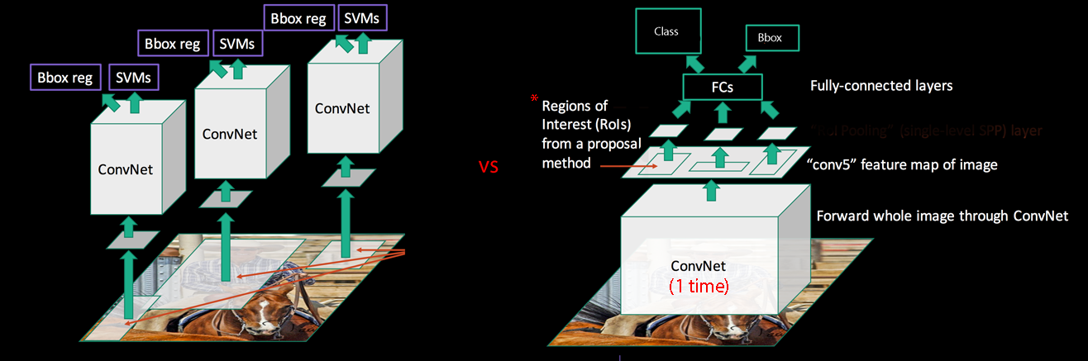
sppnet
Spatial Pyramid Pooling
“Fast R-CNN and Faster R-CNN” (jhui.github.io)

Slide 25
감사합니다!

